Slide 1
Teaching Made Easy

Slide 2
Benefits and Features
The brainchild of a developer turned senator, with an education focus, and of a tech industry attorney turned educator.
Teacher Centric
Secure
Instant Feedback for Students
Gamified Learning
Self-Grading with actionable data

Slide 3
Notes:
Begin presentation with this short intro if desired.

Slide 4
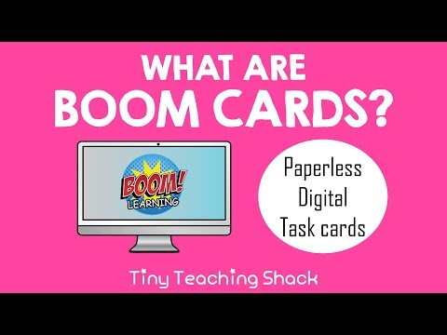
Notes:
This is a nice video overview of Boom Cards.

Slide 5
BYOD (bring your own devices)
Assignment system agnostic
Private and secure
Self-grading
Paperless
Ready made or DIY
Notes:
Why Boom Learning?
Boom Learning is designed to work with what schools and teachers have, using the practices they already us. It makes what you do now easier.

Slide 6
BYOD:
Boom Learning Works with What You Have
Compatible with your existing tools, Boom Learning works with a wide variety of hardware.
Chrome, Firefox, Safari, and Edge
Chromebooks, laptops, and desktops
Apps available for iPads, Android tablets, and Kindle Fire
Even works on smartphones (iOS and Android)
Notes:
Boom Learning works with modern hardware, such as netbooks, laptops, Chromebooks, and desktops. [Talk about what your school uses first, then anything it may be considering transitioning to.] It is designed to work on modern browsers such as Chrome, Firefox, Safari, and Edge. For devices, schools also have the option of installing dedicated player apps for iPads, Android tablets and Kindle Fire devices. Teens can even use it on their phones.

Slide 7
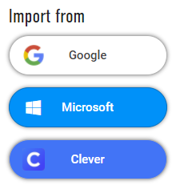
ASSIGNMENT SYSTEM AGNOSTIC
Boom Learning Works with What You Have
Teachers can use existing LMS with Hyperplay links (to record progress) or Fastplay Pins.
Google Classroom
Microsoft
Clever
Schoology
And more
Notes:
Boom Learning offers smart links that allow assignment to be done from existing web based assigning systems, such as Google Classroom, Schoology, Powerschool, Seesaw and more. Teachers can choose from Fastplay Pins, which expire after 5 days and are best for skills practice and Hyperplay links, which do not expire and log student performance. Hyperplay links are excellent for formative assessment, quick checks, and learn and assess activities.

Slide 8
COST EFFECTIVE
Spend what you need
Free Tier Membership for playing Ready-Made decks using Fastplay Pins for educators with a limited budget.
Prices for ready-made materials are set by the experienced teachers who know the need for low-cost, high-quality materials.
Notes:
Add a note that the $1 per student pricing will be introduced for fall. If they purchase now they can get much lower introductory pricing before it is phased out.

Slide 9
COST EFFECTIVE
Spend what you need
Schools who buy in bulk can obtain a discount on points used to acquire ready-made materials.
At about $2 per student for a full year of student performance reporting.
Boom Learning is a bargain compared to traditional copying and grading.
Notes:
Add a note that the $1 per student pricing will be introduced for fall. If they purchase now they can get much lower introductory pricing before it is phased out.

Slide 10
Privacy by
Design
Boom Learning was built from the ground up with privacy and security in mind.
Notes:
Co-founder Eric Oemig was software developer and software manager before running for the Washington State Senate on a platform of improving education. Co-founder Mary Oemig has over 15 years of experience in technology law, including privacy and security. She took a detour for a few years to run an education cooperative.
Together they saw that teachers were being innudated with new mandates and new tools that disrupted teaching. They also saw that many products directed at the education market were designed to change teaching, without understanding what teachers do. Last but, not least, many ed tech products had substantial problems with privacy and security.
They wanted to create something that made teachers lives easier, with tools, techniques, and practices teaches already understand. And they wanted to do so in a way that respects school and student security and privacy needs.

Slide 11
Teachers and
Students First
Our principles:
Teachers, schools, and students own and control student data
Novice teachers benefit from access to resources created by experienced teachers
Self-grading resources free teachers to teach, with immediate interventions
Paperless saves time and money
Empowered learners
Notes:
Boom Learning believes that listening to teacher and district needs is the first step to delivering a useful product. Its guiding principles put teachers and district needs in the driving seat, with a focus on freeing teacher time to teach. It also believe in connecting novice teachers to experienced teachers. [A good place to speech to a subject in your district where there are novice teachers who can benefit from materials created by experts.]

Slide 12
Freeing teachers to teach
Self-grading (or minimal grading) resources save time
Actionable data – educators can intervene, advance, or accelerate
Paperless means less waste (no paper, lamination, or copier expense) and less time to produce paper resources
Access to ready-made materials from experienced teachers means less prep time
Notes:
The self-grading feature means a teacher can know how a student performed before the student leaves the classroom. No longer is there a waiting period to discover a student is not understanding material.
With easy access to a variety of grade levels, the student who is ready to move ahead can be moved ahead with confidence that the student is grasping the material at each level of advancement with minimal additional effort on the part of the teacher.

Slide 13
Membership Capabilities
Assign Students Targeted, Individualized Curriculum
Purchase Ready-Made Curriculum in the Store
Create Customize Curriculum in the Studio
Track Student Progress and Gain Performance Insights with Reports
Notes:
The self-grading feature means a teacher can know how a student performed before the student leaves the classroom. No longer is there a waiting period to discover a student is not understanding material.
With easy access to a variety of grade levels, the student who is ready to move ahead can be moved ahead with confidence that the student is grasping the material at each level of advancement with minimal additional effort on the part of the teacher.

Slide 14
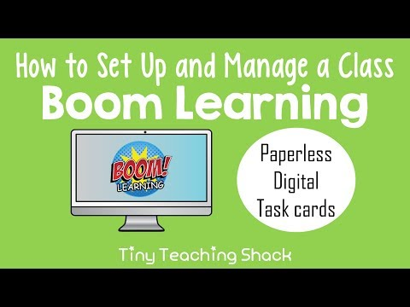
Notes:
Setting up and managing student data is easy.

Slide 15
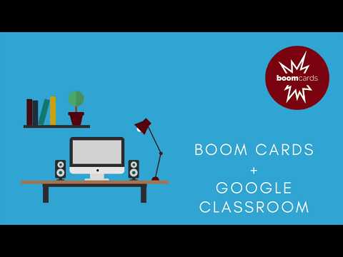
Notes:
It has built in tools to integrate with classroom assignment systems such as Google Classroom.

Slide 16
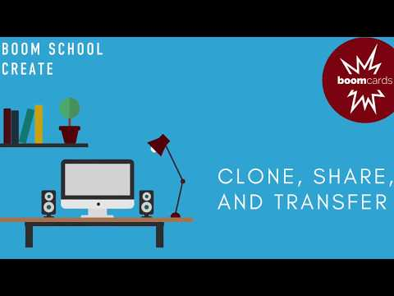
Notes:
Teachers can create their own decks and share them with each other (no need to publish in the store). This is great for create speciality materials unique to your school.

Slide 17
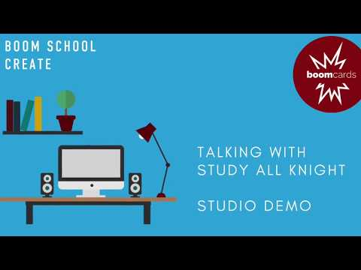

Slide 18
Top-notch community & customer service
Boom Learning manages closed Facebook support groups, so teachers can learn from each other and Boom Learning how to use the tools
Boom Learning is continuously improving its support tools
Boom Learning has highly responsive customer service

